Slide 1


Slide 2
ASSESSMENT SUBMISSION
Date assignment set | July 2021
Submission deadline task 1 | 1st November 2021
Return date to Students | 29th November 201

Slide 3

Lo1- Develops an Understanding Of Disease and ill-health and the Underlying Principles behind Inequalities in Health.
Public Health Week 4

Slide 4

Aim;
Develops an understanding of disease and ill-health and the underlying principles behind inequalities in health.
Learning outcomes;
Explore the underlying Principles Behind Inequalities In Health
Identify the Social Determinants Of Health

Slide 5

Activity-(10 minutes)
What is your understanding of health inequality?
Lets discuss…

Slide 6
https://youtu.be/NwnhWJUsUnY
This video fact file looks at what health inequities are, provides examples and shows their cost to society. Health inequities are systematic differences in the health status of different population groups according to socioeconomic status.
These inequities have significant social and economic costs, in addition to the health costs, both to individuals and societies. In all countries – whether low-, middle- or high-income – there are wide disparities in the health status of different social groups.
The lower an individual’s socio-economic position, the higher their risk of poor health.
There is ample evidence that addressing equity in societal factors (‘the social determinants of health’) including education, employment status, environment, income level, gender equity and inclusion/non-discrimination is critical to improving health equity and influencing population health in a positive way.

Slide 7
Health inequalities are the unjust and avoidable differences in people’s health across the population and between specific population groups.
Some authors, use ‘inequalities’ to denote differences between groups and ‘inequities’ to denote unjust differences between groups. The more commonly used term “inequality” has been adopted throughout this website to describe unjust differences.
Health inequalities go against the principles of social justice because they are avoidable. They do not occur randomly or by chance.
They are socially determined by circumstances largely beyond an individual’s control. These circumstances disadvantage people and limit their chance to live longer, healthier lives.

Slide 8
What is inequalities?
Health inequalities are the unjust and avoidable differences in people's health across the population and between specific population groups. ... Health inequalities go against the principles of social justice because they are avoidable. They do not occur randomly or by chance.
What are health inequalities examples?
Socio-economic status and deprivation: e.g. unemployed, low income, people living in deprived areas (e.g. poor housing, poor education and/or unemployment).
Protected characteristics: e.g. age, sex, race, sexual orientation, disability.
What is inequity?
Inequity is defined as lack of justice or fairness. Example: If two people commit the same crime and one gets convicted and the other doesn't because he can afford to hire a better lawyer, this is an example of inequity. Lack of justice; unfairness. ... Injustice; unfairness.

Slide 9
The existence of health inequalities means that the right of everyone to the highest attainable standard of physical and mental health is not being enjoyed equally across the population.
Health inequalities are unfair and avoidable differences in health across the population, and between different groups within society. Health inequalities arise because of the conditions in which we are born, grow, live, work and age.
These conditions influence our opportunities for good health, and how we think, feel and act, and this shapes our mental health, physical health and wellbeing.
Health inequalities have been documented between population groups across at least four dimensions, as illustrated in the figure below. It is important to note that these are overlapping dimensions with people often falling into various combinations of these categories.

Slide 10
Inequalities of what?
Health inequalities are ultimately about differences in the status of people’s health.
But the term is also commonly used to refer to differences in the care that people receive and the opportunities that they have to lead healthy lives, both of which can contribute to their health status. Health inequalities can therefore involve differences in:
Health status, for example, life expectancy and prevalence of health conditions
Access to care, for example, availability of treatments
Quality and experience of care, for example, levels of patient satisfaction
Behavioural risks to health, for example, smoking rates
Wider determinants of health, for example, quality of housing.

Slide 11
Inequalities between who?
Differences in health status and the things that determine it can be experienced by people grouped by a range of factors.
In England, health inequalities are often analysed and addressed by policy across four factors:
Socio-economic factors, for example, income
Geography, for example, region or whether urban or rural
Specific characteristics including those protected in law, such as sex, ethnicity or disability
Socially excluded groups, for example, people experiencing homelessness.

Slide 12
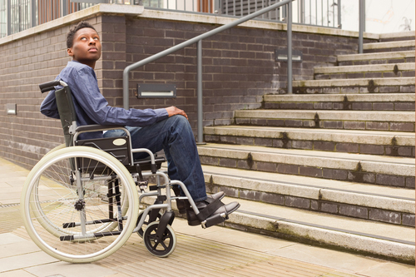
The wider environment in which people live and work then shapes their individual experiences of:
Low income
Poor housing
Discrimination
Access to health services.
This environment then shapes individual experiences across the population and leads to the inequalities in health outcomes.

Slide 13
Time, Pair, Share
Disability
Something that prevents a person from entering a building or service. For example if you are in a wheelchair and there are steps but no ramp. This is a physical barrier.
© 2015 Outstanding Resources

Slide 15
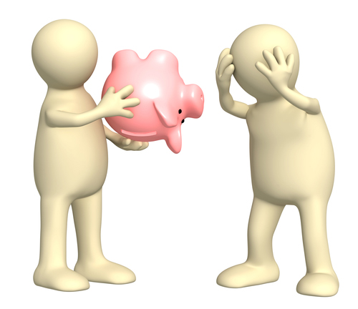
Economic factor
Things cost money. Think of childcare. If you put a child into childcare it costs you money. Some health services cost money as well.
If you do not have enough money you can sometimes miss out on vital services.
You may have to pay for travel to reach a service or you may not have enough money to pay for the service.
You have to pay when you go to the dentist and so some people don’t go to the dentist as they simply can not afford to do so.
Some people need to pay for a prescription to get their medication, if they can’t afford it they go without which could have an impact on their health.
Time, Pair, Share
© 2015 Outstanding Resources

Slide 16

Time, Pair, Share
Environment
Some people may live in a rural area where there are little services.
They may have to travel to get to any health care or early years services.
This can be a problem if they do not drive or there are few means of public transport in the area.
If it costs too much money to use petrol in a car or to use public transport then they may not go to the doctors or use other services.
© 2015 Outstanding Resources

Slide 17

Scenarios
1
Aishah needs to go to the doctors. However, the only doctor available is male and Aishah would prefer to see a female doctor. Which factor is causing the issue and how can this be overcome to remove the health inequality?
© 2015 Outstanding Resources

Slide 18

Scenarios
2
Jodie is pregnant and really wants to go to the antenatal classes in her area. Jodie is struggling to get to the local classes as she doesn’t drive and would need to get two buses to reach the class. Jodie is on her own and unemployed. Which inequality are causing the issue and how can these be overcome?
© 2015 Outstanding Resources

Slide 19
Examples of the characteristics of people/communities in each of these groups are below:
Socio-economic status and deprivation: e.g. unemployed, low income, people living in deprived areas (e.g. poor housing, poor education and/or unemployment).
Protected characteristics: e.g. age, sex, race, sexual orientation, disability
Vulnerable groups of society, or ‘inclusion health’ groups: e.g. vulnerable. migrants; Gypsy, Roma and Traveller communities; rough sleepers and homeless people; and sex workers
Geography: e.g. urban, rural.
Action on health inequalities requires improving the lives of those with the worst health outcomes, fastest.

Slide 20
People living in deprived areas
Evidence says that people living in our most deprived areas face the worse health inequalities in relation to health access, experiences and outcomes.
When we talk about deprived areas, in relation to geography, this means we are working to address inequalities in urban and rurally deprived areas of England.
What defines whether an area is a deprived area is based on a number of characteristics included in the index of Multiple Deprivation –
Income Deprivation, Employment Deprivation; Education, Skills and Training Deprivation; Health Deprivation and Disability; Crime; Barriers to Housing and Services; Living Environment Deprivation.

Slide 21
https://youtu.be/roAQHn5rEoQ
Social Inequalities in Health

Slide 22
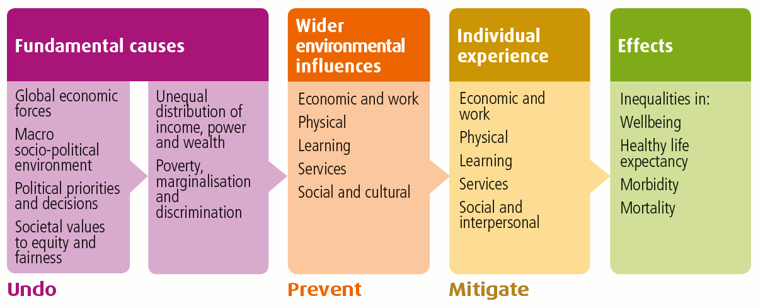
Causes of health inequalities

Slide 23
As shown in the diagram above, the fundamental causes of health inequalities are an unequal distribution of income, power and wealth. This can lead to poverty and marginalisation of individuals and groups.
These fundamental causes also influence the distribution of wider environmental influences on health, such as the availability of
Work
Education
Good quality housing.

Slide 24
This shows:
Personal characteristics occupy the core of the model and include sex, age, ethnic group, and hereditary factors
individual ‘lifestyle’ factors include behaviours such as smoking, alcohol use, and physical activity
Social and community networks include family and wider social circles
Living and working conditions include access and opportunities in relation to jobs, housing, education and welfare services
General socioeconomic, cultural and environmental conditions include factors such as disposable income, taxation, and availability of work

Slide 25
Reducing health inequalities means giving everyone the same opportunities to lead a healthy life, no matter where they live or who they are.
Currently, in England, people living in the least deprived areas of the country live around 20 years longer in good health than people in the most deprived areas.
So to tackle these inequalities we must give even more attention to those who are at greatest risk of poor health if we want to make an impact

Slide 26
Social Determinants of Health
What is social determinants of health?
Feedback to the class
Non medical factors that influences health outcomes
Conditions in the environment

Slide 27
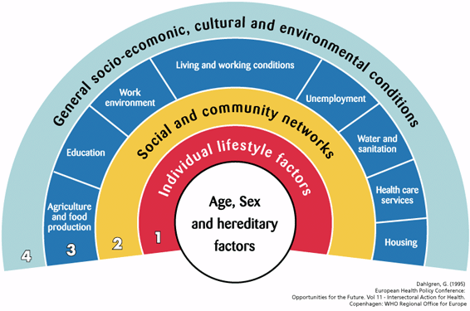
Social Determinants of Health

Slide 28
A Brief Intro into Social Determinants of Health
https://youtu.be/Lf4lFF7HlXI
Social Determinants of Health
https://youtu.be/1iSuZngvCpY
Your health is influenced by a wide range of factors, and the body you were born with is only one of them. Learn about some of the other factors that influence our health and what public health professionals do to address them.
https://youtu.be/pbP1_qd5FHQ
Social Determinants of Health Animation
https://youtu.be/zSguDQRjZv0
This video is a 4-minute summary of the Determinants of Health! Determinants are factors that can influence a person’s health. While the focus of health interventions has typically been, who people are and what they do, the conditions in which they are born, grow, live, work and age are critically important in determining the health of individuals and communities.

Slide 29
Social determinants of health (SDOH) are the conditions in the environments where people are born, live, learn, work, play, worship, and age that affect a wide range of health, functioning, and quality-of-life outcomes and risks.
The social determinants of health are the economic and social conditions that influence individual and group differences in health status.

Slide 30
What are Social Determinants of Health?
Identify the 5 known social determinants of health

Slide 31
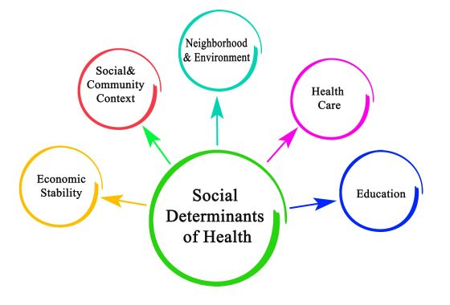
the 5 known social determinants of health

Slide 32

SDOH can be grouped into 5 domains
Economic Stability
Education Access and Quality
Health Care Access and Quality
Neighborhood and Built Environment
Social and Community Context

Slide 33
They are the health promoting factors found in one's living and working conditions (such as the distribution of income, wealth, influence, and power), rather than individual risk factors (such as behavioural risk factors or genetics) that influence the risk for a disease, or vulnerability to disease or injury.
The distributions of social determinants are often shaped by public policies that reflect prevailing political ideologies of the area.

Slide 34
Health inequalities are avoidable and unfair differences in health. They are a result of systematic differences in how people experience the determinants of health and wellbeing There are many factors which influence health outcomes.
Addressing these social determinants has the most potential to reduce health inequalities
To prevent and tackle health inequality we must address the social determinants of health: the conditions in which people are born, grow, live, work and age. These conditions affect how easy it is to get on in life and achieve our ambitions, which has a big impact on health and wellbeing.
They include our early childhood experiences and the homes and neighbourhoods we live in. Other factors include schooling and skills, our income and wealth, and our work and job prospects.
Health-related behaviours and lifestyle factors like smoking and substance misuse are also closely linked to social determinants. These circumstances are in turn shaped by a wider set of economic and social forces.

Slide 35
For example, tackling the housing crisis, improving access to good jobs, and tackling poverty will improve health and reduce health inequalities.
Reducing crime, protecting and improving the environment and creating a more productive economy will also contribute.
In other words, if wider inequalities in society are reduced then reductions in health inequalities will follow -

Slide 36
The wider determinants of health are the social, economic and environmental conditions in which people live that have an impact on health.
They include income, education, access to green space and healthy food, the work people do and the homes they live in.
It is widely recognised that, taken together, these factors are the principal drivers of how healthy people are, and that inequalities in these factors are a fundamental cause of health inequalities.
Addressing these wider socio-economic inequalities is therefore a crucial part of reducing health inequalities.

Slide 37
Below are some examples of health impacts relating to a range of wider determinants.
The examples focus on individual determinants, but these determinants are often experienced together and cumulatively over time.
Particular groups can be disadvantaged across a number of factors, and these disadvantages can be mutually reinforcing.
Deprived areas have, for example, on average nine times less access to green space, higher concentrations of fast food outlets and more limited availability of affordable healthy food.

Slide 38
https://youtu.be/pbP1_qd5FHQ

Slide 39
Social determinants of health (SDOH) have a major impact on people’s health, well-being, and quality of life. Examples of SDOH include:
Safe housing, transportation, and neighborhoods
Racism, discrimination, and violence
Education, job opportunities, and income
Access to nutritious foods and physical activity opportunities
Polluted air and water
Language and literacy skills
Social determinants of health (SDOH)

Slide 40
SDOH also contribute to wide health disparities and inequities.
For example, people who don't have access to grocery stores with healthy foods are less likely to have good nutrition.
That raises their risk of health conditions like heart disease, diabetes, and obesity — and even lowers life expectancy relative to people who do have access to healthy foods.
Just promoting healthy choices won't eliminate these and other health disparities. Instead, public health organizations and their partners in sectors like education, transportation, and housing need to take action to improve the conditions in people's environments.

Slide 41
Economic Stability: Help people earn steady incomes that allow them to meet their health needs.
Many people can’t afford things like healthy foods, health care, and housing. Healthy People 2030 focuses on helping more people achieve economic stability.
People with steady employment are less likely to live in poverty and more likely to be healthy, but many people have trouble finding and keeping a job. People with disabilities, injuries, or conditions like arthritis may be especially limited in their ability to work.
In addition, many people with steady work still don’t earn enough to afford the things they need to stay healthy.

Slide 42
Employment programs, career counselling, and high-quality child care opportunities can help more people find and keep jobs.
In addition, policies to help people pay for food, housing, health care, and education can reduce poverty and improve health and well-being.
Income and work are 2 of the most important determinants of health and wellbeing.
Unemployment has been falling in England, down to 5.1% in 2015, but this proportion increases to 8.4% for people living in the most deprived areas, more than double that of people in the least deprived areas (3.4%).

Slide 43
The quality of available work can also play a part in health outcomes both physically and mentally.
A healthy standard of living such as adequate income and housing is associated with many positive health outcomes.
In the financial year 2014 to 2015, just under a third (30.2%) of individuals lived in households with an income below the minimum income standard and this was higher amongst children (45.7%) and children in lone parent families (74.5%).

Slide 44
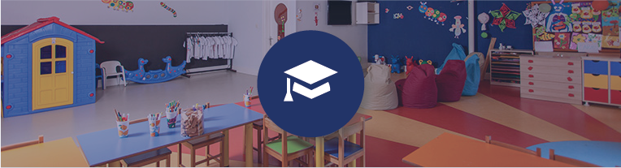
Education Access and Quality
Increase educational opportunities and help children and adolescents
Educational attainment is strongly linked with health behaviours and outcomes. More educated individuals are less likely to suffer from long-term diseases and to report themselves in poor health, or suffer from mental disorders such as depression or anxiety
Children from low-income families, children with disabilities, and children who routinely experience forms of social discrimination — like bullying — are more likely to struggle with math and reading.
They’re also less likely to graduate from high school or go to college. This means they’re less likely to get safe, high-paying jobs and more likely to have health problems like heart disease, diabetes, and depression.

Slide 45
Cont..
Children growing up in more deprived areas often suffer disadvantages throughout their lives, from educational attainment through to employment prospects, which in turn affect physical and mental wellbeing.
In addition, some children live in places with poorly performing schools, and many families can’t afford to send their children to college. The stress of living in poverty can also affect children’s brain development, making it harder for them to do well in school.
Interventions to help children and adolescents do well in school and help families pay for college can have long-term health benefits do well in school.
Children are assessed for their ‘school-readiness’ upon completion of the Reception Year in school, at around 5 years of age.

Slide 46
Cont..
To achieve a ‘good level of development’ a child should have reached the expected level in early learning goals around communication and language, physical development, and personal, social and emotional development.
For example paying attention, listening to stories, using the toilet, dressing themselves, and they should have started to read, write and do simple sums
In the academic year 2015 to 2016, just under a third of those who were not eligible for free school meals were not ready for school at age 5, compared with almost half of children who were eligible and 1 in 20 young people living in deprived areas were NEET compared to 1 in 33 living in the least deprived areas.
Although the percentages of children not ready for school, and young people not in education, employment or training (NEET) have both fallen in recent years, inequalities remain.

Slide 47

Health Care Access and Quality-
Increase access to comprehensive, high-quality health care services
Sometimes people don’t get recommended health care services, like cancer screenings, because they don’t have a primary care provider.
Other times, it’s because they live too far away from health care providers who offer them.
Interventions to increase access to health care professionals and improve communication — in person or remotely — can help more people get the care they need.

Slide 48
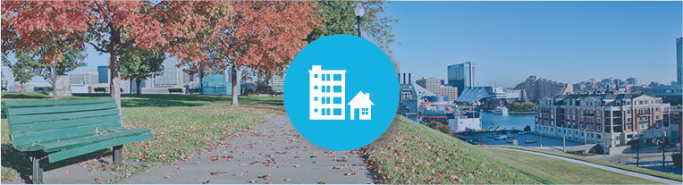
Neighbourhood and Built Environment
Create neighbourhoods and environments that promote health and safety.
The neighbourhoods people live in have a major impact on their health and well-being
Racial/ethnic minorities and people with low incomes are more likely to live in places with these risks. In addition, some people are exposed to things at work that can harm their health, like second-hand smoke or loud noises.
Interventions and policy changes at the local and national level can help reduce these health and safety risks and promote health. For example, providing opportunities for people to walk and bike in their communities — like by adding sidewalks and bike lanes — can increase safety and help improve health and quality of life.

Slide 49

 | What comes to mind when you think of a healthy neighborhood? What does it take to make a neighborhood more healthy? Find out why conditions in some communities might be less favorable to health than others and what can be done to change them.
https://unnaturalcauses.org/interactivities.php

Slide 50
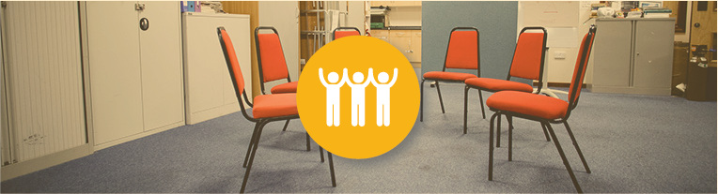
Social and Community Context
Increase social and community support
People’s relationships and interactions with family, friends, co-workers, and community members can have a major impact on their health and well-being.
Many people face challenges and dangers they can’t control — like unsafe neighbourhoods, discrimination, or trouble affording the things they need. This can have a negative impact on health and safety throughout life.

Slide 51
Cont….
Positive relationships at home, at work, and in the community can help reduce these negative impacts. But some people — like children whose parents are in jail and adolescents who are bullied — often don’t get support from loved ones or others.
Interventions to help people get the social and community support they need are critical for improving health and well-being.

Slide 52
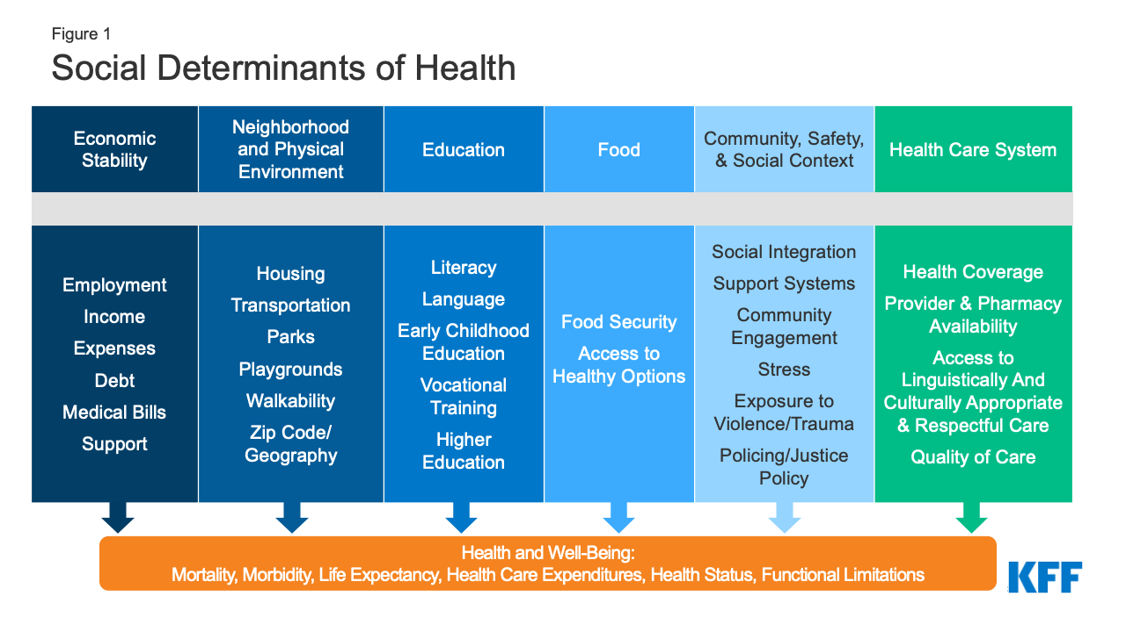

Slide 53
https://youtu.be/_11xLlwKgWc
From the video clip, about Jeff (from rich home) and Chad (from poor home)
Identify how each of the five social determinants of health impact on each of the individual
Feedback to the class by discussing these factors

Slide 54
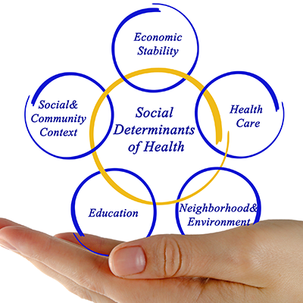
Selected impacts of wider determinants on our health

Slide 55
Selected impacts of wider determinants on our health

Slide 56
C0nt….

Slide 57
C0nt….
The Organisation for Economic Co-operation and Development (OECD) is an intergovernmental economic organisation with 38 member countries, founded in 1961 to stimulate economic progress and world trade.

Slide 58
National Actions in reducing health inequality
Nationally, the focus should be on implementing the measures which are most likely to be effective in reducing health inequalities. This means trying to discontinue or modify measures which have been shown to widen, or potentially widen, inequalities.
There is also an important role for national agencies, including public and third sector organisations, to support local delivery through advocacy and evidence building.

Slide 59
Cont….
Health Inequalities Policy Review shows that tackling health inequalities requires a combination of action to
Undo the fundamental causes
Prevent the harmful wider environmental influences
Mitigate (make less harmful) the negative impact on individuals.

Slide 60
Local actions
Locally, public resources need to be allocated according to need so that they do not make inequalities worse, and may make a contribution towards their reduction.
Providing universal services with added intensive support for vulnerable groups (known as proportionate universalism) is effective at reaching all of those that need them by ensuring that there are fewer or no barriers in terms of
Price
Stigma
Accessibility
Discrimination.

Slide 61
However, some people continue to experience barriers to accessing services, including
Physical
Language
Attitudinal
Information.
These include people from minority ethnic or LBGTI (Lesbian, Gay, Bisexual, Transgender or Intersex) population groups or people living with poverty, disability or mental health problems. Additional efforts are also required to ensure equality of access to services for those living furthest from service provision.

Slide 62
Reference
https://www.england.nhs.uk/ltphimenu/definitions-for-health-inequalities/#health-inequalities
https://health.gov/healthypeople/objectives-and-data/browse-objectives/health-care-access-and-quality
https://publichealthmatters.blog.gov.uk/2017/07/13/understanding-health-inequalities-in-england/
http://www.healthscotland.scot/health-inequalities/what-are-health-inequalities

